Slide 1

Faulty equation system

Slide 2
INTRODUCTION
A Faulty equation system is a system where the number of equations is bigger than the unknown variables
NOTE!
Faulty equation system has an infinite solution number due to is a dependent system type

Slide 3

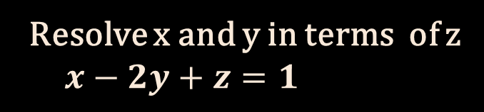
Faulty equation system Exercise !!!
Resolve x and y in terms of z
$$x−2y+z=1$$
$$x+y+4z=1$$

Slide 4

Step 1: We put “z” as part of the independent terms
$$x−2y= 1−z$$
$$x+y=1−4z$$

Slide 5
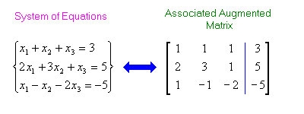
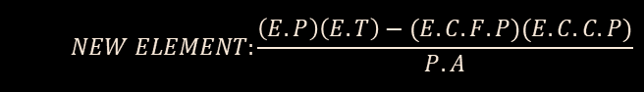
Step 2: We choose to solve with an augmented matrix by the Montante´s method
Montante´s method
Augmented matrix
$$NEW ELEMENT:\frac{\left(E.P\right)\left(E.T\right)−(E.C.F.P)(E.C.C.P)}{P.A}$$

Slide 6
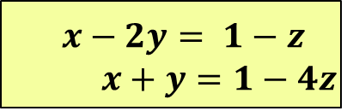





Step 2: We choose to solve with an augmented matrix by the Montante method
$$x−2y= 1−z$$
$$x+y=1−4z$$
It transformed to 0 due to is up the pivot
Anterior pivot
Coefficients of y
Pivot
$$\begin{matrix}1 & −2 & 1−z \\ 0 & 3 & −3z\end{matrix}$$
$$\begin{matrix}1 & −2 & 1−z \\ 1 & 1 & 1−4z\end{matrix}$$
$$\begin{matrix}3 & 0 & 3−9z \\ 0 & 3 & −3z\end{matrix}$$
$$\sim$$
$$\sim$$
Coefficients of x
It transformed to 0 due to is under the pivot
New Pivot

Slide 7
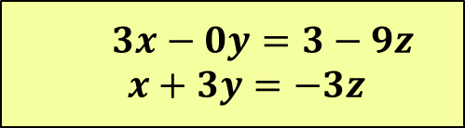


From the last matrix we obtained:
Last matrix
$$3x−0y=3−9z$$
$$x+3y=−3z$$
$$\begin{matrix}3 & 0 & 3−9z \\ 0 & 3 & −3z\end{matrix}$$
$$\sim$$

Slide 8

01
02
OVERVIEW
ASSIGNMENT
FEATURES OF THE TOPIC
03
04
ABOUT THE TOPIC

Slide 9

1.61803
3.141592653
7
1525
is the approximate value of the golden ratio
are the first ten digits of π (pi)
are the different letters used to represent Roman numerals
is the year in which the radical symbol was first used in print

Slide 10
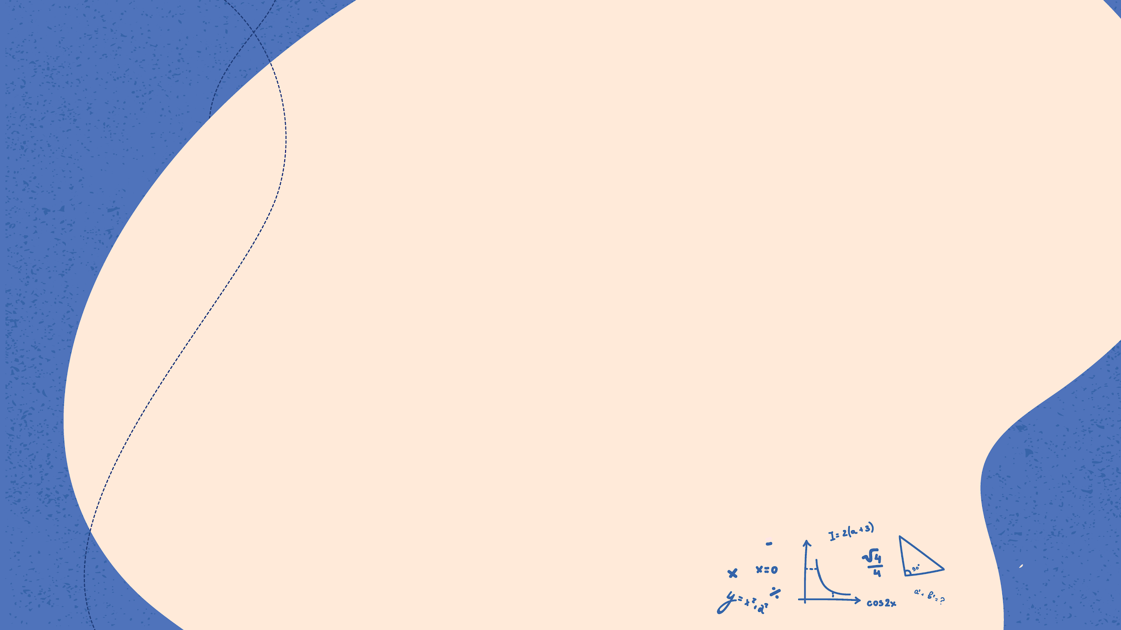
—SOMEONE FAMOUS
“This is a quote. Words full of wisdom that someone important said and can make the reader get inspired.”

Slide 11

WHAT IS THIS TOPIC ABOUT?
Here you could give a brief description of the matter you want to talk about. For example, if you want to talk about Mercury, you could say that it’s the closest planet to the Sun and the smallest one in the Solar System. It’s only a bit larger than our Moon, and its name has nothing to do with the liquid metal, since it was named after the Roman messenger god, Mercury

Slide 12
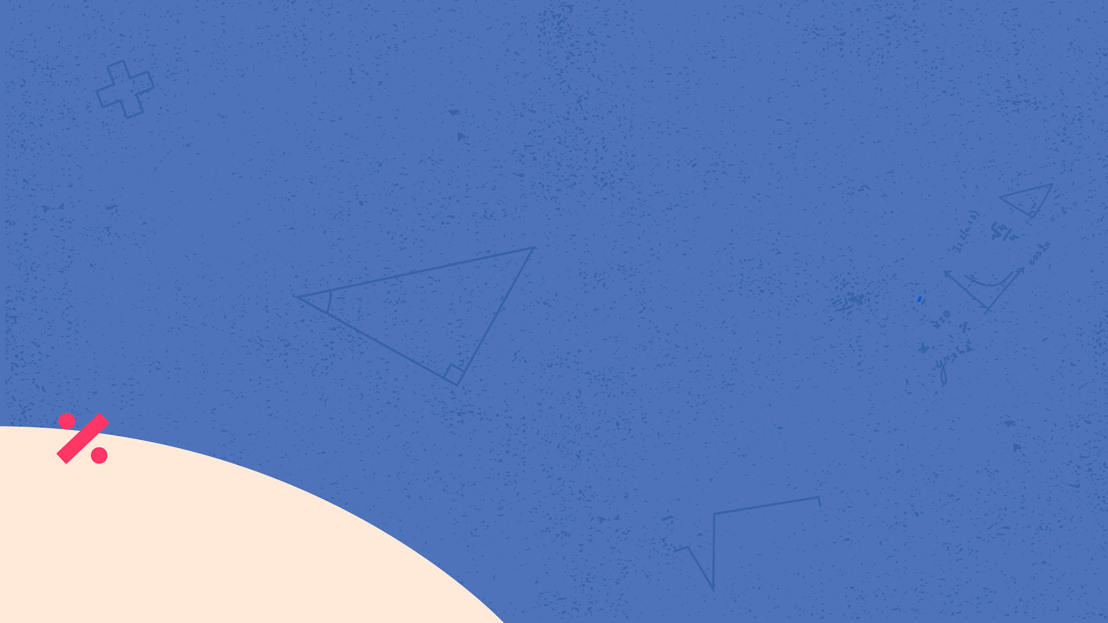
DEFINITION OF CONCEPTS
MERCURY
MARS
SATURN
Mercury is the closest planet to the Sun and the smallest one in the Solar System
Despite being red, Mars is a cold place, not hot. It’s full of iron oxide dust, giving the planet its reddish cast
Saturn is the ringed planet. It’s a gas giant, composed mostly of hydrogen and helium

Slide 13

PRACTICAL USES OF THIS SUBJECT
V | 5 | Five
X | 10 | Ten
L | 50 | Fifty
Do you know what helps you make your point clear? Lists like this one:
Because they’re simple
You can organize your ideas clearly
And because you’ll never forget to buy milk!
And the most important thing: the audience won’t miss the point of your presentation

Slide 14

FEATURES OF THE TOPIC
MERCURY
Mercury is the closest planet to the Sun and the smallest one in the Solar System
MARS
Despite being red, Mars is a cold place, not hot. It’s full of iron oxide dust
JUPITER
It’s a gas giant and the biggest planet in our Solar System

Slide 15
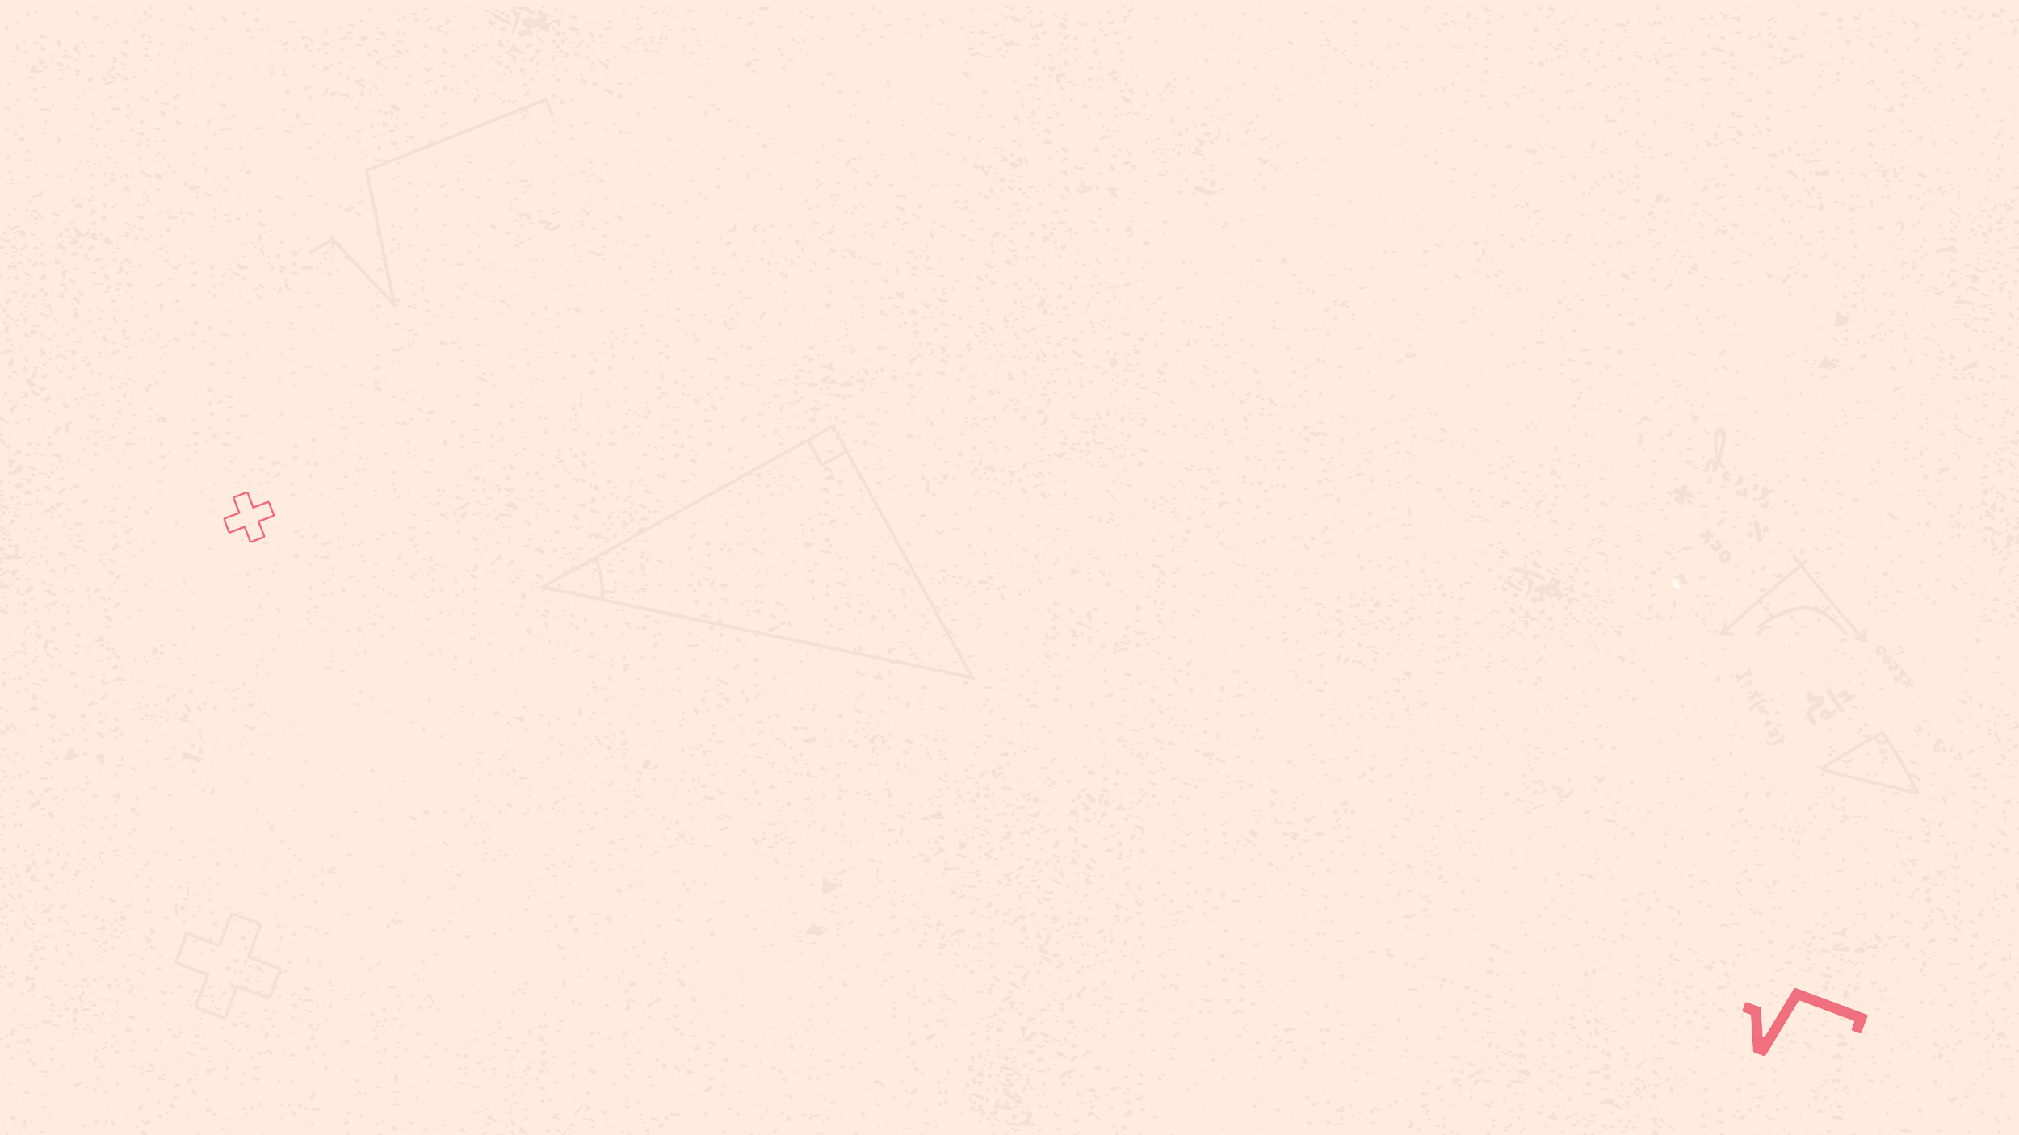
CASE STUDY
The square of the hypotenuse is equal to the sum of the squares of the other two sides in a right triangle

Slide 16
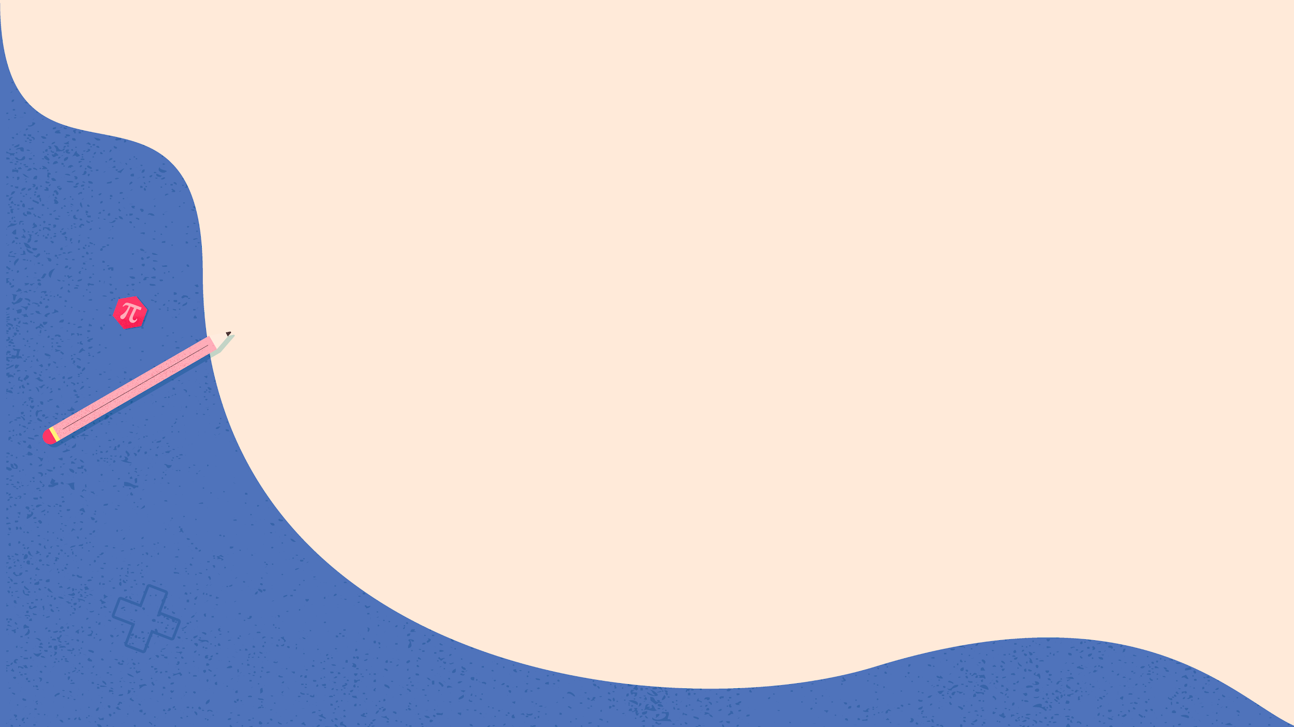
DID YOU KNOW THIS?
The abacus is the oldest calculating tool, and it’s still used in some countries
To make a paper plane, it’s best if you use a square paper instead of a rectangular one
The hypotenuse is the longest side of a right triangle, which is opposite the right angle
The number or expression placed underneath the radical sign is called radicand

Slide 17
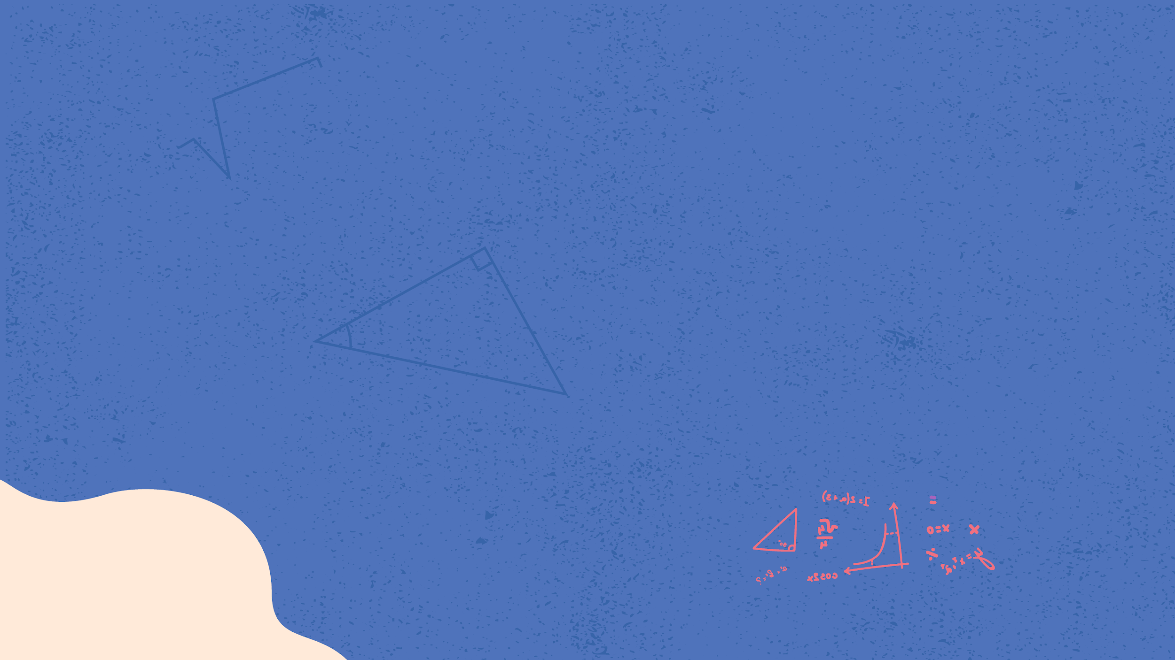
PROBLEM VS. SOLUTION
PROBLEM
SOLUTION
Venus has a beautiful name and is the second planet from the Sun
Despite being red, Mars is a cold place, not hot. It’s full of iron oxide dust

Slide 18

PROCESS
Step 1
Step 2
Step 3
Despite being red, Mars is a cold place, not hot. It’s full of iron oxide dust
Venus has a beautiful name and is the second planet from the Sun
Neptune is the fourth-largest planet in our Solar System

Slide 19

OVERVIEW DIAGRAM
Mercury is the closest planet to the Sun and the smallest one in our Solar System
Saturn is the ringed one. It’s a gas giant, composed mostly of hydrogen and helium
Neptune is the farthest planet from the Sun and the fourth-largest in our Solar System

Slide 20
EXERCISE
Mercury is the closest planet to the Sun, but does its name have anything to do with the liquid metal?
Contrary to popular belief, no. The truth is that this planet was named after the Roman messenger god, Mercury

Slide 21
ASSIGNMENT
Mercury is the closest planet to the Sun, and Neptune is the farthest one. Calculate the distance between these two planets

Slide 22
THANKS!
Does anyone have any questions?
addyouremail@freepik.com
+91 620 421 838
yourcompany.com

